Slide 1
SUSTAINABILITY & ESG Optimising Food Recycling
Name: Nidhi Sinha
Institute of Higher Learning: Don Bosco Institute of Technology
Field of Study: Artificial Intelligence & Machine Learning[CSE]
Email: sinhaniya2071@gmail.com
* For your clear and concise presentation, please attempt ALL the questions in this template.

Slide 2
Self-Introduction
Your Interests:I'm particularly interested in emerging technologies such as artificial intelligence, machine learning,blockchain, Internet of Things (IoT),Big Data& Hadoop latest programming languages, frameworks, and tools.
Your Superpowers:With a combination of skills and experiences herein some of my best vised abilities, my ability to think outside the box. I possess a creative and innovative mindset that allows me to approach challenges from unconventional angles. I enjoy exploring unique solutions and breaking free from traditional thought patterns.My adaptability,exceptional problem-solving abilities and effective communication.
Your Weaknesses:Balancing Perfectionism,alongside my emotions can be my weak breakthrough since I supposedly keeps people over every materialistic things.Though not the true definition of “Heavenly Human” but Virtuous to be one.

Slide 3

Problem Statement Selection
Problem Statement | Please Tick the Problem You are Attempting (✓)
FINTECH Enhance Singapore-India Trade Connectivity Trust is always the top concern in conducting cross-border trade and overseas expansion. Solution Needed: How can we create a secured and automated platform for the accreditation, certification, and validation of proof-of-work or quality of work of Micro, Small and Medium Enterprises (MSMEs) to accelerate and boost trade connectivity between Singapore and India?
SUSTAINABILITY & ESG Optimising Food Recycling Everyday, tonnes of food in urban cities is thrown away because they could not be consumed before expiry. Food wastage not only has a big impact on the environment, but also could have been better used to feed communities in need. Create a platform that connects food suppliers (restaurants, grocery stores, catering services) with local food banks and non-profit organisations. Solution Needed: The platform should use data analytics to optimise food rescue routes, minimize transportation costs, and maximize benefits to communities in need. Instead of throwing away food that is close to expiry, or has been cooked but not consumed, can we organise rescue efforts for these food items so that they can be redistributed to those in need? Collection and redistribution logistics are key, and the app should optimise timing and route transport so as to minimize transport costs while ensuring food does not sit around and spoil while waiting to be re-distributed to those in need. Transport distances also cannot be too far for the same reasons.

Slide 4
Identify the Problem Owner
Who owns this problem? Or whose problem are you solving?
Government and Regulatory Bodies: Governments play a crucial role in setting policies, regulations, and standards related to sustainability and environmental practices. They are responsible for creating a conducive framework that encourages and supports sustainable food recycling initiatives. This includes implementing regulations on waste management, providing incentives for recycling, and promoting sustainable practices in the food industry.
Food Industry and Businesses: The food industry, including producers, manufacturers, retailers, and restaurants, has a significant role to play in optimizing food recycling. They are responsible for adopting sustainable practices throughout the food supply chain, reducing food waste, implementing efficient recycling systems, and supporting initiatives for composting or converting food waste into useful resources.
Consumers: Consumers have a responsibility to make sustainable choices and reduce food waste at the individual level. This includes mindful shopping, proper storage and handling of food, utilizing leftovers, and supporting businesses that prioritize sustainable practices.
Waste Management Companies: They are responsible for collecting, processing, and recycling food waste efficiently. They play a vital role in implementing sustainable waste management practices, including composting, anaerobic digestion, or converting food waste into renewable energy sources.
NGOs and Environmental Organizations: They often take an active role in promoting sustainable practices, raising awareness, and providing support and guidance to various stakeholders. They play a significant role in advocating for sustainable food recycling solutions and driving positive change through campaigns and initiatives.

Slide 5
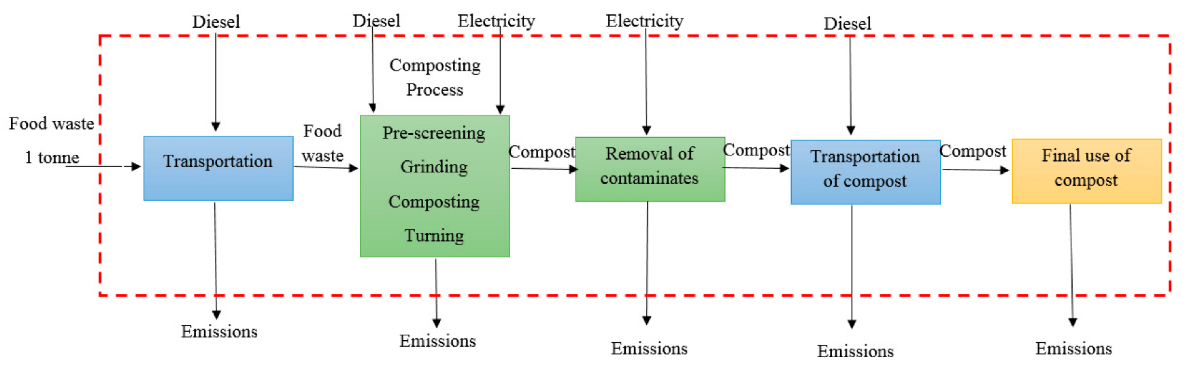
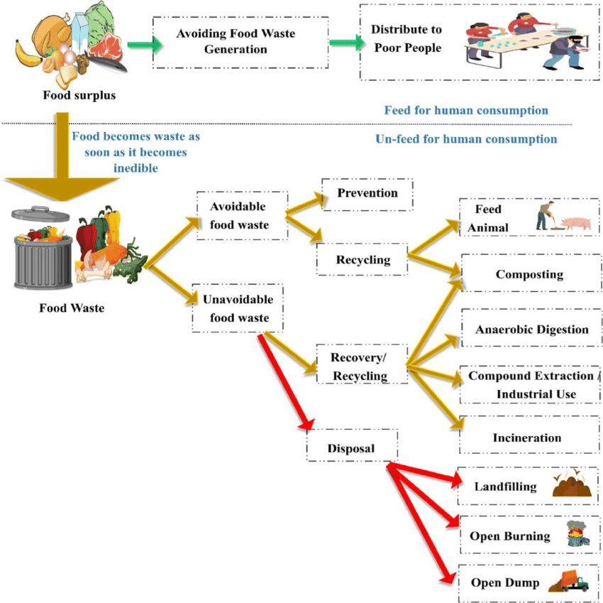
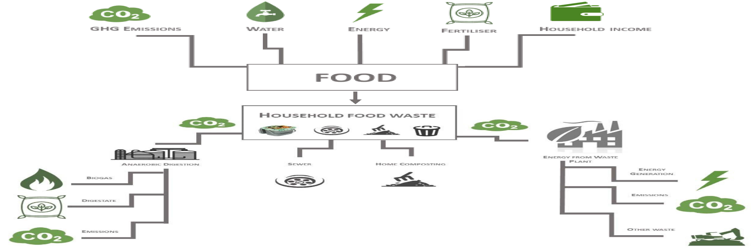
Your Idea / Solution
How are you going to solve the problem?
Use pictures and diagrams to better explain your solution.
If you already have a prototype, explain and show how your prototype works.

Slide 6
Impact of Solution
How serious is this problem to the owner? You should seek to quantify the impact of your solution to solve the problem, based on either or all of the following measures:
Financial in terms of cost saving, revenue potential;
Performance in terms of productivity gain, quality, lower risk etc;
Image in terms of positive social consequences, e.g. status, reputation, etc.
Financial Impact: Implementing efficient food recycling practices can result in significant cost savings for owners. By reducing waste disposal costs and potentially generating new revenue streams from recycled resources, businesses can improve their bottom line and overall financial performance.
Performance Impact: Optimized food recycling processes can lead to productivity gains and operational efficiencies. By streamlining waste management, businesses can save time and resources, allowing them to focus on core activities. Additionally, effective food waste management helps maintain quality standards, mitigating risks associated with contamination and ensuring customer satisfaction.
Image Impact: Adopting sustainable practices like food recycling has positive social consequences and contributes to a business's image and reputation. Demonstrating a commitment to environmental responsibility can enhance the owner's standing within the industry and attract customers who prioritize sustainability. A positive reputation for sustainability can also foster partnerships with like-minded organizations and investors.

Slide 7
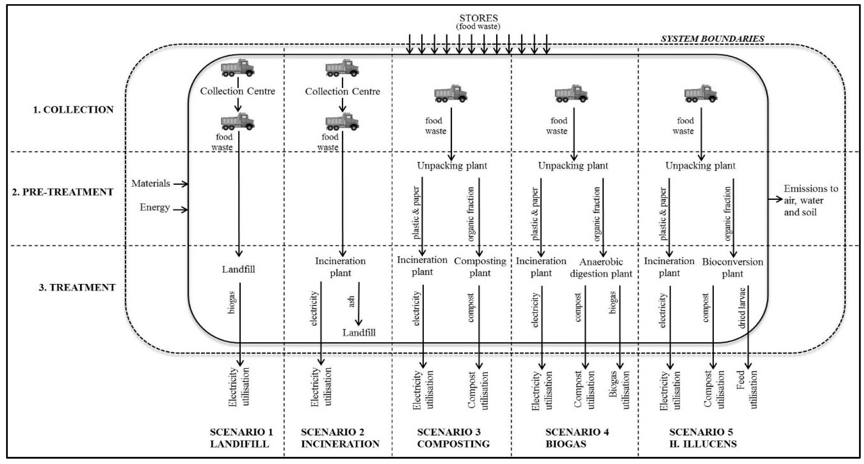
Competition
*Bonus Slide
How is your solution/approach better than others? Who are the existing direct/indirect competitors or substitutes? Use a comparative chart/table to illustrate.

